Slide 1
LCAP Mid-Year Update
Los Angeles Leadership Primary Academy
January 23, 2024

Slide 2
Agenda
Overview of Requirements
Updated Budget Overview for Parents
LCAP Goals
Progress towards meeting goal
Implementation and Expenditure Status

Slide 3
Local Control Accountability Plan (LCAP)
What is it?
Focus Area
A comprehensive state plan required of districts and charter schools that details key goals, actions, and budgeted expenditures.
How additional funds are being used to benefit higher need student groups
(Low Income, English Learner, and Foster Youth)
Notes:
Use or hide slide depending on background knowledge of group.

Slide 4
Local Control Accountability Plan (LCAP)
LCAP as SPSA
Charter schools may use the LCAP to also serve as the School Plan for Student Achievement (SPSA) to describe how federal funds will be used to increase student achievement.
Notes:
Use or hide slide depending on background knowledge of group.

Slide 5
LCAP Components 2023-24
Mid-Year 2023-24 Annual Update Board Presentation
Currently available LCAP Outcomes
LCFF Financial Expenditures YTD
LCAP Actions Implementation Update
New annual requirement
2024-25 LCAP - New 3-Year Plan
Budget Overview for Parents
2023-24 Annual Update Actions and Expenditures
Highlights, Identified Needs, Education Partner Engagement
2024-25 Goals, Outcomes, Actions, Expenditures
Increased and Improved Services Requirement
Traditional LCAP Components

Slide 6
Updated Budget Overview for Parents
A concise summary of revenues and expenditures for this year.

Slide 7
Budget Overview for Parents
Budget Item | Original Forecast 23-24 | Current Forecast 23-24 Budget as of 10/31/23 | Difference
Total LCFF funds | $4,100,186 | $4,115,340 | $15,154
LCFF supplemental and concentration grants | $1,106,715 | $1,121,869 | $15,154
All other state funds | $2,993,471 | $1,880,844 | -$1,112,627
All local funds | $0 | $20,368 | $20,368
All federal funds | $538,938 | $1,015,420 | $476,482
Total projected revenue | $6,326,655 | $7,031,972 | $705,317
Total budgeted general fund expenditures | $6,180,710 | $6,517,063 | $336,353

Slide 8
LCAP Goals: Progress and Implementation Status

Slide 9
Increase student achievement in ELA and Math to close the achievement gap between student subgroups and the general population based on the CA Dashboard.
1
Action # | Action Title (* increased service for high need students) | Status | Budgeted Amount | Expenditures as of 10/31/23
1 | Curriculum and Instructional materials * | Complete | $39,000 | $36,046.93
2 | Tutoring Services | In Progress | $653,634 | $47,085.00
3 | Intervention * | In Progress | $314,464 | $82,680.74
4 | Academic Progress Monitoring * | In Progress | $71,630 | $6,665.33
5 | Professional Development * | In Progress | $48,734 | $8,543.58
6 | Technology and Digital Resources * | In Progress | $130,975 | $61,477.19
7 | High-Quality Instruction | In Progress | $1,970,478 | $279,756.23
8 | English Learner Support * | In Progress | $46,037 | $13,089.75
9 | Special Education | In Progress | $644,330 | $140,988.24

Slide 10
Goal 1 Outcomes
Metric | Baseline | Year 1 Outcome | Year 2 Outcome | Year 3 Outcome | Desired Outcome for 2023–24
% of students with access to standards-aligned instructional materials | 100% | 100% | 100% | 100% | 100%
Implementation of CA adopted standards | 100% | 100% | 100% | 100% | 100%
% of students enrolled in broad course of study | 100% | 100% | 100% | 100% | 100%
EL Reclassification Rate | 2019-20: 9.1% | 2020-21 11.6% | Not yet available | Not yet available | 15%

Slide 11
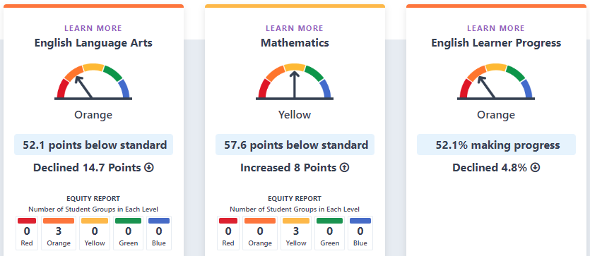
2023 Academic Indicators
CA state = Orange
CA state = Orange
CA state = Yellow

Slide 12
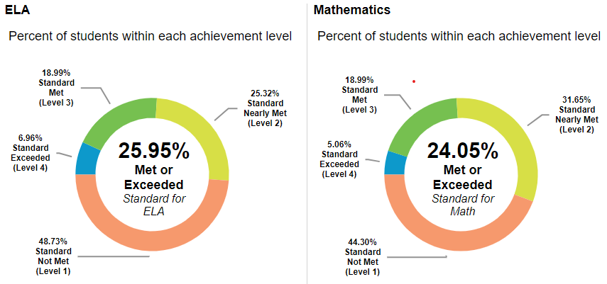
2023
CA state average 47% Met or Exceeded ELA Standard
CA state average 35% Met or Exceeded Math Standard

Slide 13
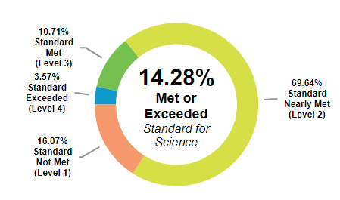
CA state average 30% Met or Exceeded Standard
2023

Slide 14
Work collaboratively with students, staff, families, and the community to increase resources in order to provide a supportive schooling experience that attends to all the different academic and social-emotional needs of the students.
2
Action # | Action Title (* increased service for high need students) | Status | Budgeted Amount | Expenditures as of 10/31/23
1 | Family Events | In Progress | $ - | $-
2 | Workshops | In Progress | $ - | $-
3 | Family and Community Outreach * | In Progress | $29,451 | $7,810.20

Slide 15
Goal 2 Outcomes
Metric | Baseline | Year 1 Outcome | Year 2 Outcome | Year 3 Outcome | Desired Outcome for 2023–24
School social media and two-way communication outlets: -ParentSquare -Facebook -Instagram -ClassDojo | 132 IG followers 85%Class Dojo 90%Parent Square 290 FB followers | 166 IG Followers 95% ClassDojo Parent Square 98% 62 FB followers | 2022-23 220 IG followers 97% Class Dojo 98% Parent Square 75 FB followers | 2023-24 67 FB followers | Increase followers and connected families by 5% each year from baseline
% of parents participating in annual parent survey | 40% | 2021-22 51% | 2022-23 86% | Data Not Yet Available | 85%
% of parents participating in parent conferences | 80% | 2021-22 90% | 2022-23 90% | Data Not Yet Available | 100%

Slide 16
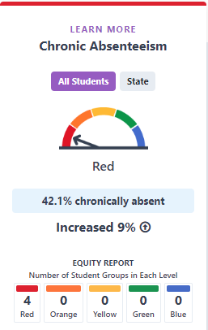
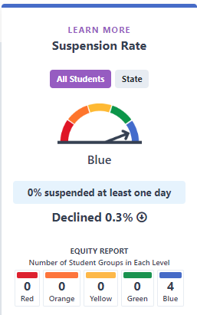
2023 Engagement/ Climate Indicators
CA state = Yellow
CA state = Orange

Slide 17
Ensure the school site has a safe, inclusive, and welcoming climate for all students and their families, so that all students are in their classes ready to learn.
3
Action # | Action Title (* increased service for high need students) | Status | Budgeted Amount | Expenditures as of 10/31/23
1 | Safe and Clean Campus | In Progress | $627,261 | $228,110.49
2 | PBIS Program * | In Progress | $49,826 | $12,279.18
3 | Enrichment Activities * | In Progress | $56,500 | $6,432.47
4 | Nutrition Program | In Progress | $359,099 | $31,388.34
5 | Student Uniforms * | In Progress | $1,500 | $132.81
6 | Mental Health | In Progress | $ - | $-
7 | Attendance Support * | In Progress | $69,778 | $23,477.42

Slide 18
Goal 3 Outcomes
Metric | Baseline | Year 1 Outcome | Year 2 Outcome | Year 3 Outcome | Desired Outcome for 2023–24
Attendance Rate | 2019-20 95% | 2021-22 89.26% | 2022-23 89.8% | as of 9/26/23 TK-5 94.5% 6-8 94.6% | 96.5%
Chronic Absence Rate | 2018-19 12.7% | 2020-21 15.7% | 2021-22 33% | 2022-23 42% | 20%
Suspension Rate Expulsion Rate | 2019-20 0% 0% | 2020-21 0% 0% | 2021-22 0.3% 0% | 2022-23 0% 0% | <3% 0%
Facilities Condition | 2020-21 Good | 2021-22 Good | 2022-23 Good | 2023-24 Good | Good
Parent and Student survey results will be available at the end of the school year.

Slide 19
Thank you for working together to review our progress towards meeting our LCAP goals!

