Slide 1
CEO/Superintendent Legislative and Legal Updates

Slide 2
Capitol Update
SB 579 – Amended to Address Current Year Funding Shortfall for Charter Schools
In its current form, SB 579 would provide an additional year of hold harmless funding for Average Daily Attendance for 2022-2023, but would not address 2021-2022
The California Charter Schools Association (CCSA) has been advocating to address the 2021-2022 shortfall for charter schools
As of January 20, 2022, the CCSA was successful, and the author amended SB 579 to address the funding shortfall for charter schools for the 2021-2022 school year
This bill must pass the Senate floor and then move on to the Assembly
It is likely that any final actions on this issue will ultimately need to be aligned with the State Budget, which will not be finalized until June 15

Slide 3
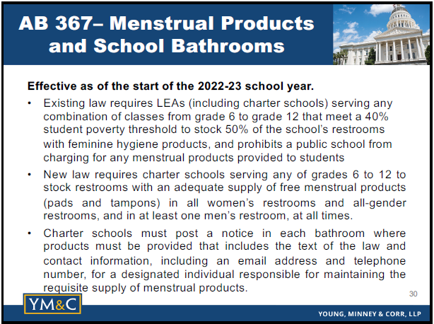
Legal Updates

Slide 4
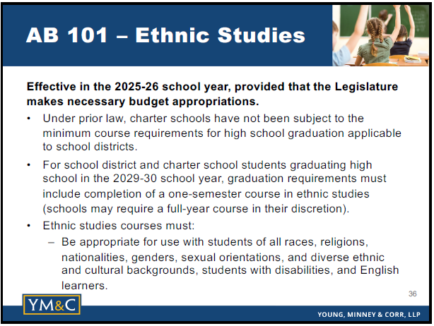
Legal Updates

Slide 5
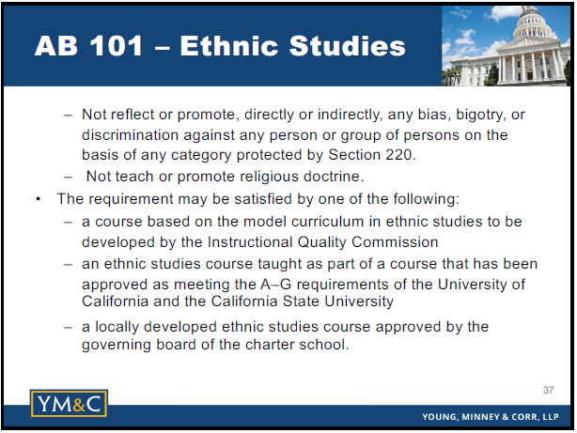
Legal Updates

Slide 6
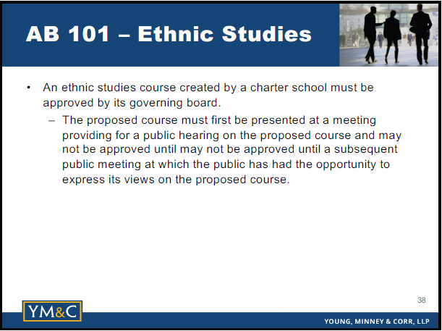
Legal Updates

Slide 7
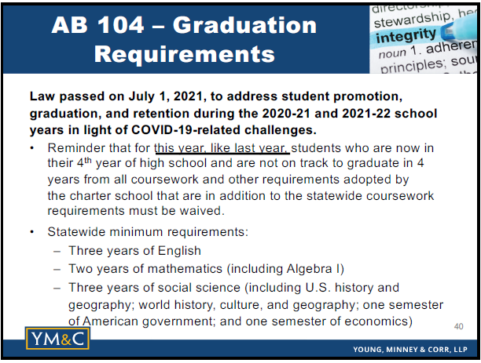
Legal Updates

Slide 8
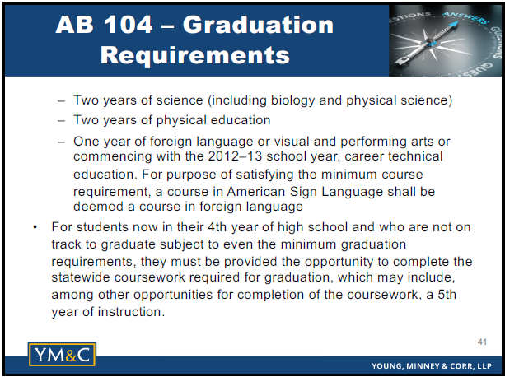
Legal Updates

Slide 9
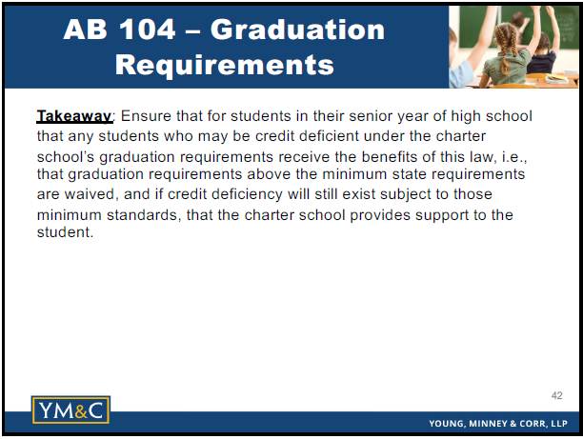
Legal Updates

Slide 10
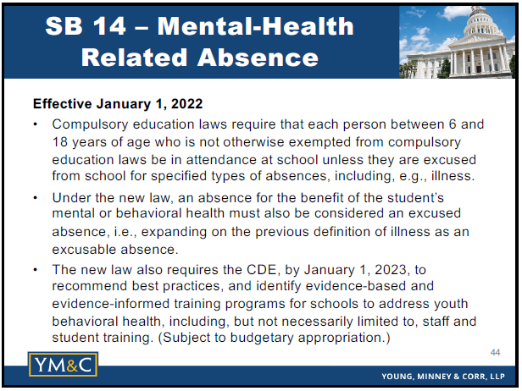
Legal Updates

Slide 11
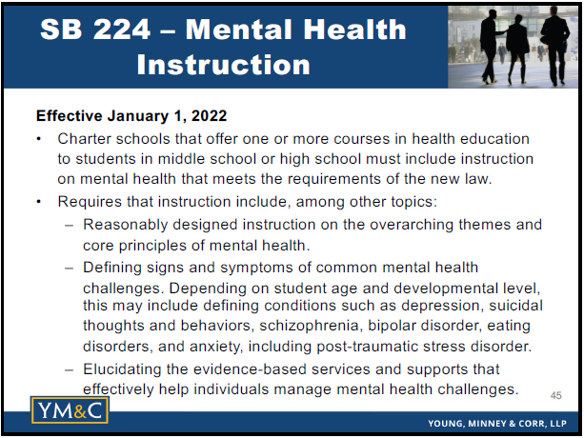
Legal Updates

Slide 12
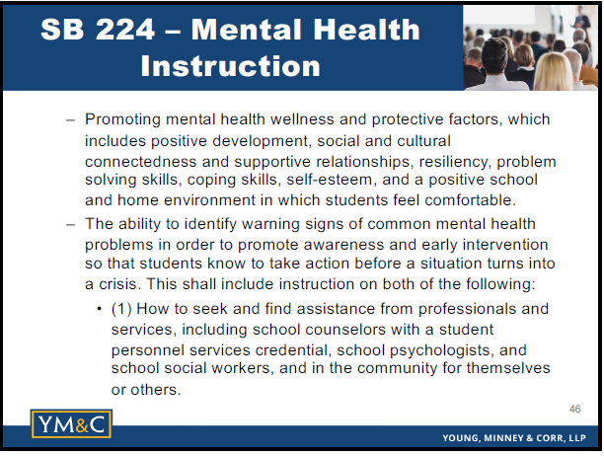
Legal Updates

Slide 13
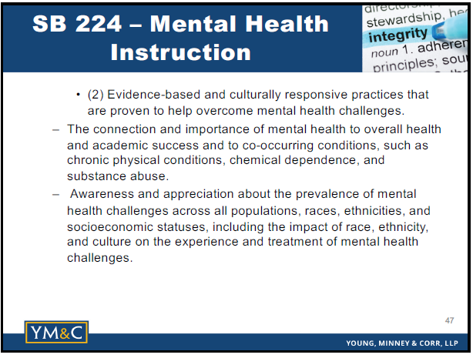
Legal Updates

Slide 14
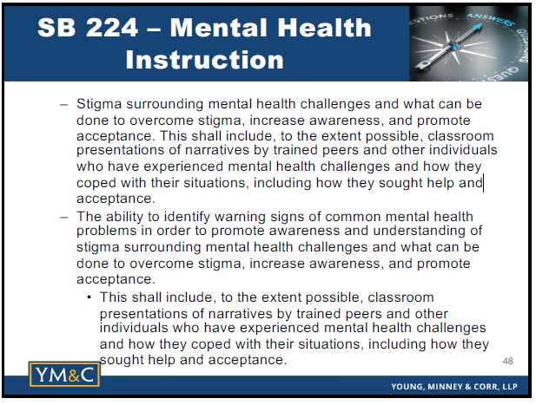
Legal Updates

Slide 15
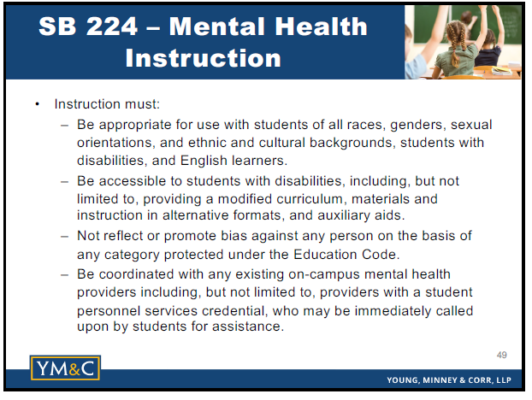
Legal Updates

Slide 16
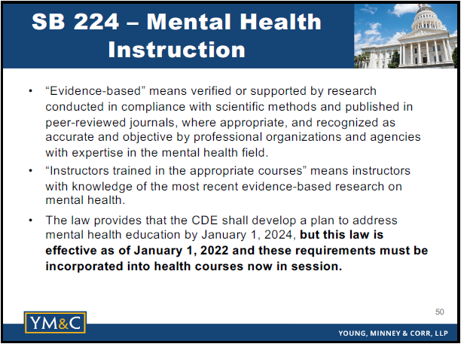
Legal Updates

Slide 17
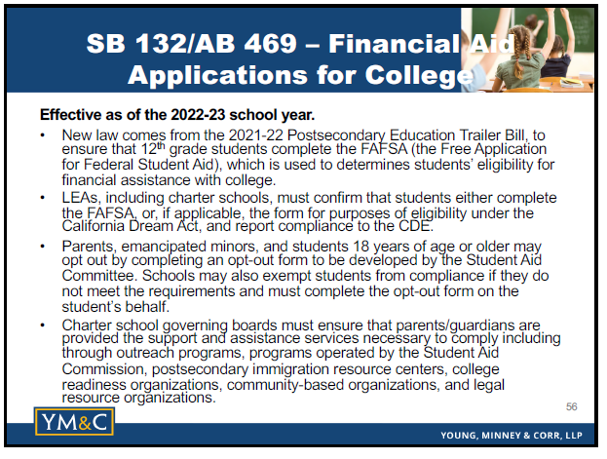
Legal Updates

Slide 18
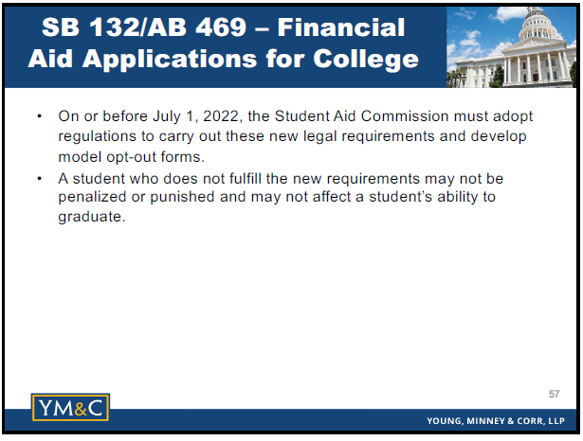
Legal Updates

Slide 19
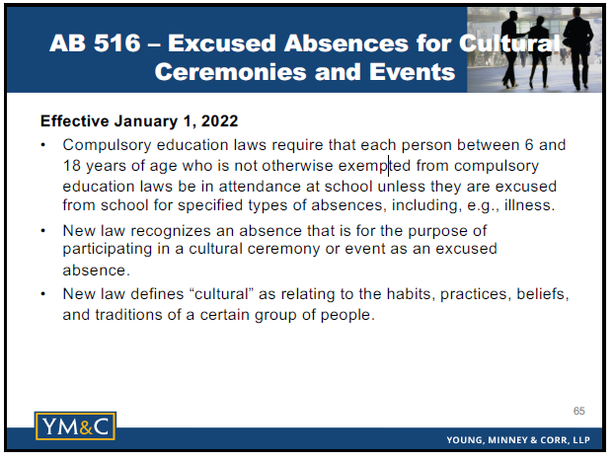
Legal Updates

Slide 20
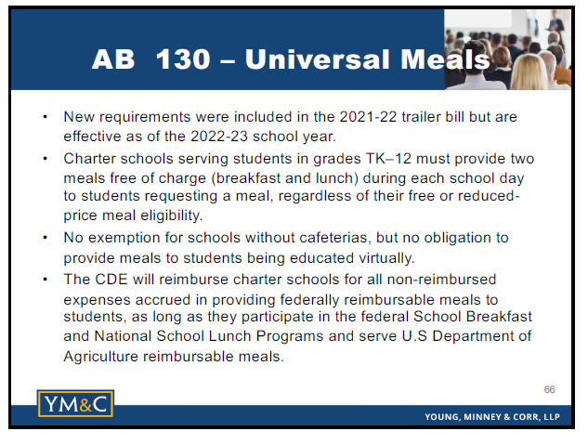
Legal Updates

Slide 21
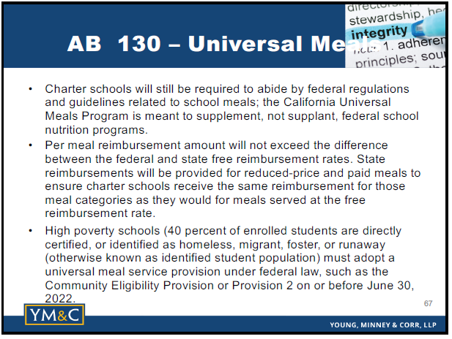
Legal Updates

Slide 22
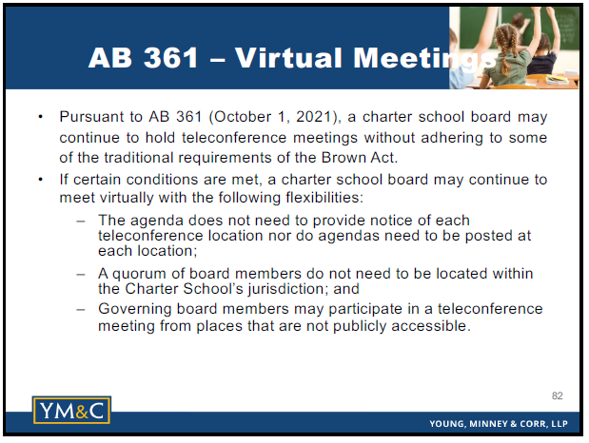
Legal Updates

Slide 23
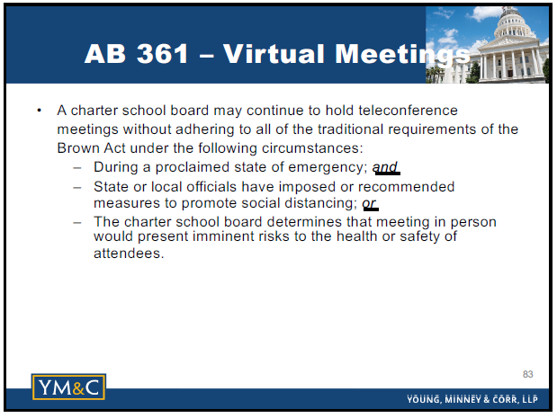
Legal Updates

Slide 24
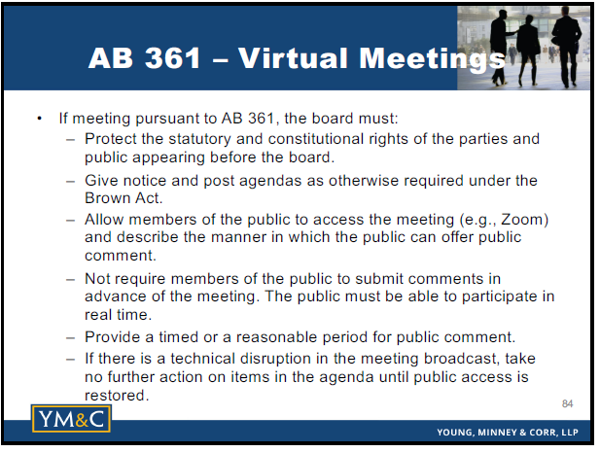
Legal Updates

Slide 25
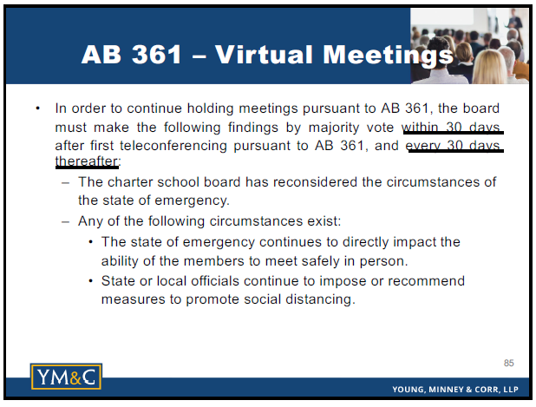
Legal Updates

Slide 26
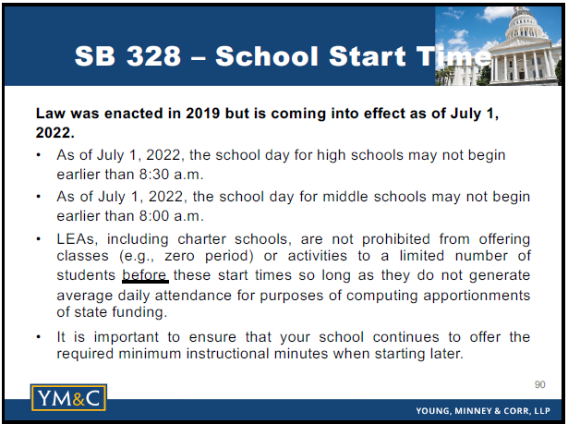
Legal Updates

