Slide 1
LCAP Mid-Year Update
Los Angeles Leadership Academy
January 23, 2024

Slide 2
Agenda
Overview of Requirements
Updated Budget Overview for Parents
LCAP Goals
Progress towards meeting goal
Implementation and Expenditure Status

Slide 3
Local Control Accountability Plan (LCAP)
What is it?
Focus Area
A comprehensive state plan required of districts and charter schools that details key goals, actions, and budgeted expenditures.
How additional funds are being used to benefit higher need student groups
(Low Income, English Learner, and Foster Youth)
Notes:
Use or hide slide depending on background knowledge of group.

Slide 4
Local Control Accountability Plan (LCAP)
LCAP as SPSA
Charter schools may use the LCAP to also serve as the School Plan for Student Achievement (SPSA) to describe how federal funds will be used to increase student achievement.
Notes:
Use or hide slide depending on background knowledge of group.

Slide 5
LCAP Components 2023-24
Mid-Year 2023-24 Annual Update Board Presentation
Currently available LCAP Outcomes
LCFF Financial Expenditures YTD
LCAP Actions Implementation Update
New annual requirement
2024-25 LCAP - New 3-Year Plan
Budget Overview for Parents
2023-24 Annual Update Actions and Expenditures
Highlights, Identified Needs, Education Partner Engagement
2024-25 Goals, Outcomes, Actions, Expenditures
Increased and Improved Services Requirement
Traditional LCAP Components

Slide 6
Updated Budget Overview for Parents
A concise summary of revenues and expenditures for this year.

Slide 7
Budget Overview for Parents
Budget Item | Original Forecast 23-24 | Current Forecast 23-24 Budget as of 10/31/23 | Difference
Total LCFF funds | $5,635,589 | $5,628,388 | -$7,201
LCFF supplemental and concentration grants | $1,526,437 | $1,519,236 | -$7,201
All other state funds | $1,441,255 | $1,710,793 | $269,538
All local funds | $1,000 | $74,365 | $73,365
All federal funds | $626,276 | $1,230,565 | $604,289
Total projected revenue | $7,704,120 | $8,644,111 | $939,991
Total budgeted general fund expenditures | $8,491,765 | $8,593,087 | $101,322

Slide 8
LCAP Goals: Progress and Implementation Status

Slide 9
Increase student achievement in ELA and Math to close the achievement gap between student subgroups and the general population.
1
Action # | Action Title (* increased service for high need students) | Status | Budgeted Amount | Expenditures as of 10/31/23
1 | Curriculum and Instructional materials * | Complete | $77,765 | $111,774
2 | Tutoring Services | In Progress | $192,597 | $72,688
3 | Intervention * | In Progress | $260,517 | $49,829
4 | Academic Progress Monitoring * | In Progress | $176,372 | $57,407
5 | Professional Development * | In Progress | $32,250 | $27,483
6 | Technology and Digital Resources * | In Progress | $357,364 | $148,494
7 | High-Quality Instruction | In Progress | $2,508,403 | $346,567
8 | English Learner Support | In Progress | $128,424 | $31,708
9 | Special Education | In Progress | $562,952 | $122,101

Slide 10
Goal 1 Outcomes
Metric | Baseline | Year 1 Outcome | Year 2 Outcome | Year 3 Outcome | Desired Outcome for 2023–24
% of students with access to state-adopted instructional materials | 100% | 100% | 100% | 100% | 100%
Implementation of state adopted content standards, including ELD | ELA and Math standards Full Implementation and Sustainability ELD, History-Social Science, and NGSS Standards Full Implementation |  |  |  | Full Implementation & Sustainability
% of students enrolled in a broad course of study | 100% | 100% | 100% | 100% | 100%
% of teachers properly credentialed and appropriately assigned | 100% properly credentialed 0 misassignments |  | 2020-21 97% properly credentialed 0.8 misassigned | 2021-22 89% properly credentialed 2.7 misassigned | 100% properly credentialed 0 misassigned
EL Reclassification Rate | 2019-20: 0% | 2020-21 14.2% | Not yet available | Not yet available | 20%
Notes:
Add Dashboard Data

Slide 11
Goal 1 Outcomes (cont’d)
Metric | Baseline | Year 1 Outcome | Year 2 Outcome | Year 3 Outcome | Desired Outcome for 2023–24
Advanced Placement participation rates | 2018-19 32% | 2021-22 24% | 2022-23 24% | Not Yet available | 35%
Advanced Placement Passing Rates | 2018-19 12% | 2020-21 79% | 2021-22 10% | Not Yet available | 15%
% of graduates completing A-G requirements | 2019-20 90.4% | 2020-21 94.3% | 2021-22 68.8% | 2022-23 55% | 95%
% of students prepared for college by EAP | 2018-19 ELA: 58% Math: 13% | 2020-21 ELA 46% Math 20% | 2021-22 ELA 35% Math 7% | 2022-23 ELA 41% Math 9% | ELA: 45% Math: 17%
Notes:
Add Dashboard Data

Slide 12
Goal 1 Outcomes (cont’d)
Metric | Baseline | Year 1 Outcome | Year 2 Outcome | Year 3 Outcome | Desired Outcome for 2023–24
High School Graduation Rate | 2019-20 80% | 2020-21 All Students: 72% SED: 72% Hispanic 71% | 2021-22 All:71% EL: 56% SWD: 64% SED: 71% Hispanic: 69% | 2022-23 All: 88% EL: 82% SED: 88% Hisp: 89% | 80%
CA Science Test (CAST) % meeting or exceeding standards | 2018-19 All Students 9% SED: 8% Hispanic 6% EL: 0% SWD: 0% | 2020-21 All Students 10% SED: 9% Hispanic 9% EL: 3% SWD: 12% | 2021-22 All Students 10% SED 12% Hispanic 10% EL: 0% SWD: 0% | 2022-23 All Students: 9% SED: 9% Hispanic 9% EL: 0% SWD: 0% | 2022-23 All Students: 12%
Notes:
Add Dashboard Data

Slide 13
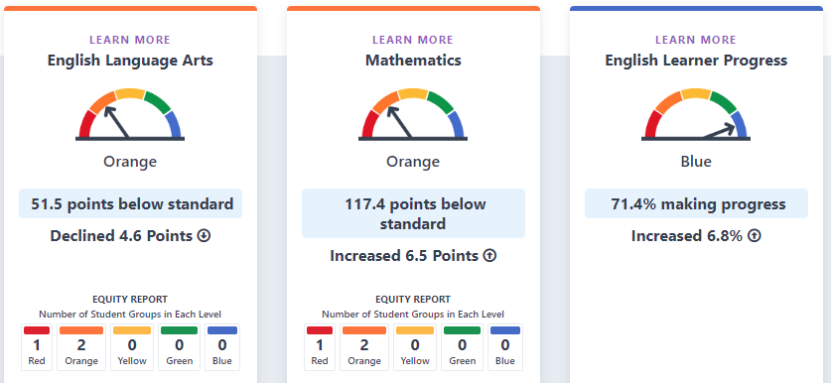
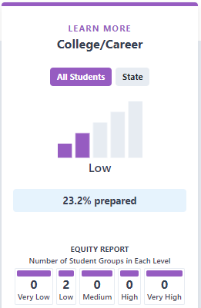
2023 Academic Indicators
CA state Orange
CA state Orange
CA state Yellow
CA Medium 44%

Slide 14
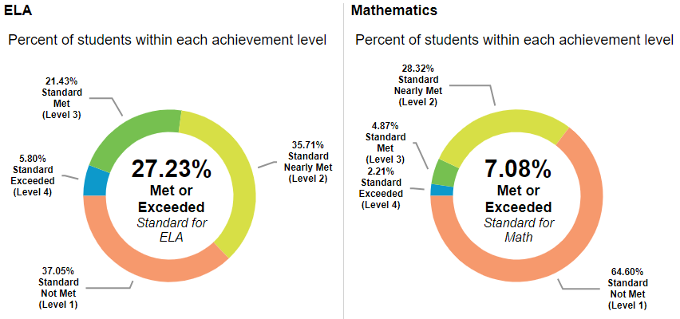
2023
CA state average 47% Met or Exceeded ELA Standard
CA state average 35% Met or Exceeded Math Standard

Slide 15
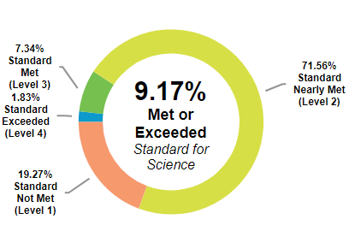
CA state average 30% Met or Exceeded Standard
2023

Slide 16
Work collaboratively with students, staff, families, and the community to increase resources in order to provide a supportive schooling experience that attends to all the different academic and social-emotional needs of the students.
2
Action # | Action Title (* increased service for high need students) | Status | Budgeted Amount | Expenditures as of 10/31/23
1 | Family Events | In Progress | $ - | $-
2 | Workshops | In Progress | $ - | $-
3 | Family and Community Outreach * | In Progress | $6,500 | $1,038

Slide 17
Goal 2 Outcomes
Metric | Baseline | Year 1 Outcome | Year 2 Outcome | Year 3 Outcome | Desired Outcome for 2023–24
% of parents participating in annual parent survey | 2021-22 Middle School 26% High School 23% | N/A | 2022-23 65% | Data Not Yet Available | 60%
% of parents participating in school events | No data due to events hosted virtually during the pandemic | N/A | 2022-23 80% | Data Not Yet Available | 75%
Notes:
Customize for each school. This is a sample placeholder table.

Slide 18
Provide a safe and supportive schooling experience that attends to the social and emotional development of students and their growth as agents of social justice.
3
Action # | Action Title (* increased service for high need students) | Status | Budgeted Amount | Expenditures as of 10/31/23
1 | Safe and Clean Campus | In Progress | $804,233 | $286,686
2 | PBIS Program * | In Progress | $54,826 | $12,279
3 | Enrichment Activities | In Progress | $195,000 | $75,045
4 | Nutrition Program | In Progress | $407,099 | $67,672
5 | Student Uniforms * | In Progress | $8,814 | $5,276
6 | Mental Health | In Progress | $ - | $-
7 | Attendance Support * | In Progress | $159,706 | $57,518

Slide 19
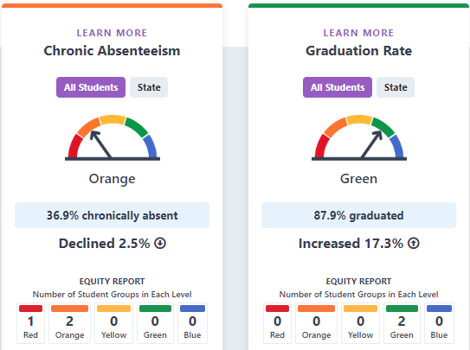
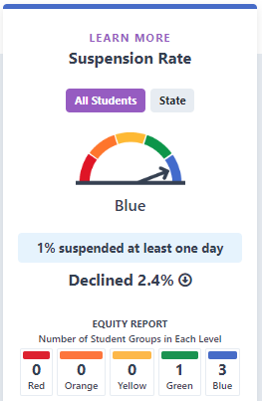
2023 Climate/Engagement Indicators
CA state = Yellow
CA state = Orange
CA state = Orange

Slide 20
Goal 3 Outcomes
Metric | Baseline | Year 1 Outcome | Year 2 Outcome | Year 3 Outcome | Desired Outcome for 2023–24
Average Daily Attendance | 2019-20 94% | 2021-22 88.37% | 2022-23 89.2% | 2023-24 6-8th 95% as of 9/26/23 | 96.5%
Chronic Absence Rate | 2018-19 13.5% | 2020-21 11.2% | 2021-22 39.5% | 2022-23 37.6% | 20%
Suspension Rate Expulsion Rate | 2019-20 1.9% 0% | 2020-21 0% 0% | 2021-22 3.3% 0% | 2022-23 1% 0% | <3% 0%
Facilities Condition | 2020-21 Good | 2021-22 Good | 2022-23 Good | 2023-24 Good | Good

Slide 21
Goal 3 Outcomes
Metric | Baseline | Year 1 Outcome | Year 2 Outcome | Year 3 Outcome | Desired Outcome for 2023–24
Survey Results: % agree school is safe | 2021-22 Strongly Agree 27% Agree 41% Neutral 31% | N/A | 2022-23 30% Strongly agree 50% Agree | Not yet available | 75%
High School Dropout Rate | 2019-20 17% | 2020-21 12.2% | 2021-22 23.4% | 2022-23 12.5% | 10%
Middle School Dropout Rate | 2020-21 0% | N/A | 2021-22 0% | Not yet available | 0%

Slide 22
Thank you for working together to review our progress towards meeting our LCAP goals!

